Slide 1


Academic and Curricular
Advising Management System
Academic and Curricular advising Management System

Slide 2
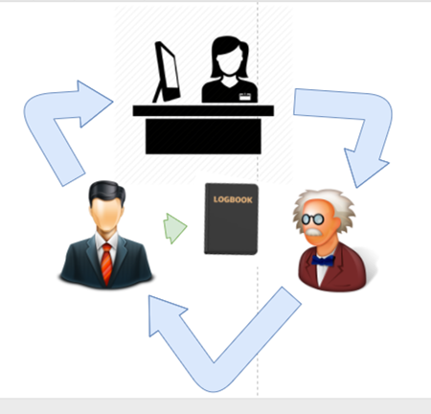
PROBLEM | CASE 1
PROBLEM
PROPOSED SOLUTION
OBJECTIVES
USER
LOG IN
USER HOMEPAGE
REGISTRATION
FORGOT PASSWORD
CASE
GENERATE REPORTS
IMPORT FROM EXCEL FILE
Academic and Curricular advising Management System

Slide 3
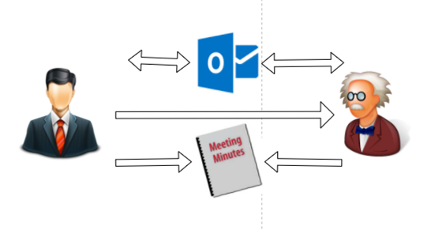
PROBLEM | CASE 2
PROBLEM
PROPOSED SOLUTION
OBJECTIVES
USER
LOG IN
USER HOMEPAGE
REGISTRATION
FORGOT PASSWORD
CASE
GENERATE REPORTS
IMPORT FROM EXCEL FILE
Academic and Curricular advising Management System

Slide 4


PROPOSED SOLUTION
PROBLEM
PROPOSED SOLUTION
OBJECTIVES
USER
LOG IN
USER HOMEPAGE
REGISTRATION
FORGOT PASSWORD
CASE
GENERATE REPORTS
IMPORT FROM EXCEL FILE
1 MEETING = 1 CASE
Case ID # : ___________ Date Created: _____
Nature: ___________
Category: ___________
Sub- Category : _______
Date Closed: _____
DATE / TIME / USER ID
DATE / TIME USER ID
Student
Faculty
Academic and Curricular advising Management System
Academic and Curricular advising Management System

Slide 5


PROPOSED SOLUTION
PROBLEM
PROPOSED SOLUTION
OBJECTIVES
USER
LOG IN
USER HOMEPAGE
REGISTRATION
FORGOT PASSWORD
CASE
GENERATE REPORTS
IMPORT FROM EXCEL FILE
CASE 1
CASE 2
CASE 3
CASE 4
Request
Report
View
Report
Academic and Curricular advising Management System
Academic and Curricular advising Management System

Slide 6


PROPOSED SOLUTION | CURRICULAR
PROBLEM
PROPOSED SOLUTION
OBJECTIVES
USER
LOG IN
USER HOMEPAGE
REGISTRATION
FORGOT PASSWORD
CASE
GENERATE REPORTS
IMPORT FROM EXCEL FILE
A
B
A
B
Academic and Curricular advising Management System
Academic and Curricular advising Management System

Slide 7


PROPOSED SOLUTION | CURRICULAR
PROBLEM
PROPOSED SOLUTION
OBJECTIVES
USER
LOG IN
USER HOMEPAGE
REGISTRATION
FORGOT PASSWORD
CASE
GENERATE REPORTS
IMPORT FROM EXCEL FILE
Adviser A
Adviser B
Academic and Curricular advising Management System
Academic and Curricular advising Management System

Slide 8


PROPOSED SOLUTION
PROBLEM
PROPOSED SOLUTION
OBJECTIVES
USER
LOG IN
USER HOMEPAGE
REGISTRATION
FORGOT PASSWORD
CASE
GENERATE REPORTS
IMPORT FROM EXCEL FILE
LOCATION 1
Faculty
LOCATION 2
Case 1
Case 2
Case 3
LOCATION 3
Academic and Curricular advising Management System
Academic and Curricular advising Management System

Slide 9


PROPOSED SOLUTION | ACADEMIC
PROBLEM
PROPOSED SOLUTION
OBJECTIVES
USER
LOG IN
USER HOMEPAGE
REGISTRATION
FORGOT PASSWORD
CASE
GENERATE REPORTS
IMPORT FROM EXCEL FILE
CASE 1
Current Subject
Past Subject
Academic and Curricular advising Management System
Academic and Curricular advising Management System

Slide 10
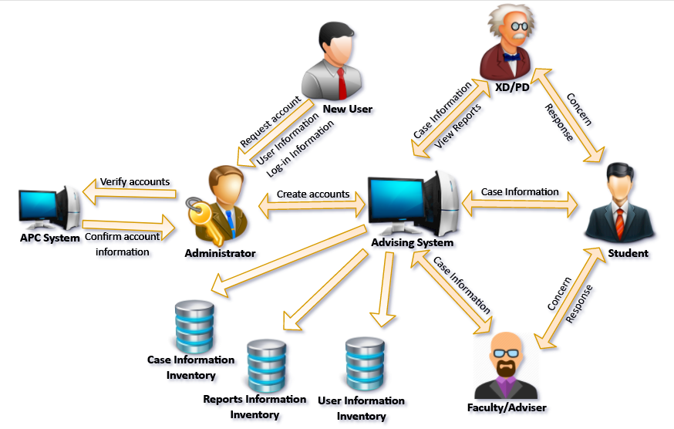
PROPOSED SOLUTION
PROBLEM
PROPOSED SOLUTION
OBJECTIVES
USER
LOG IN
USER HOMEPAGE
REGISTRATION
FORGOT PASSWORD
CASE
GENERATE REPORTS
IMPORT FROM EXCEL FILE
Academic and Curricular advising Management System

Slide 11
OBJECTIVES | GENERAL OBJECTIVE
PROBLEM
PROPOSED SOLUTION
OBJECTIVES
USER
LOG IN
USER HOMEPAGE
REGISTRATION
FORGOT PASSWORD
CASE
GENERATE REPORTS
IMPORT FROM EXCEL FILE
To develop and design a web-based intranet system for Asia Pacific College – School of Engineering that will serve as a medium of communication for student and faculty and to centralize students’ academic and curricular advising records.
Academic and Curricular advising Management System

Slide 12
OBJECTIVES | SPECIFIC OBJECTIVES
PROBLEM
PROPOSED SOLUTION
OBJECTIVES
USER
LOG IN
USER HOMEPAGE
REGISTRATION
FORGOT PASSWORD
CASE
GENERATE REPORTS
IMPORT FROM EXCEL FILE
Develop:
Registration
Log in
Case
Reports
Academic and Curricular advising Management System

Slide 13


USER | MODULE ACCESS LEVEL
PROBLEM
PROPOSED SOLUTION
OBJECTIVES
USER
LOG IN
USER HOMEPAGE
REGISTRATION
FORGOT PASSWORD
CASE
GENERATE REPORTS
IMPORT FROM EXCEL FILE
USER ROLE | LOGIN | REGISTRATION | CASE | REPORTS
Executive Dir.
Program Dir.
Adviser
Faculty
Student
Admin
Academic and Curricular advising Management System

Slide 14
USER | CASE ACCESS LEVEL
PROBLEM
PROPOSED SOLUTION
OBJECTIVES
USER
LOG IN
USER HOMEPAGE
REGISTRATION
FORGOT PASSWORD
CASE
GENERATE REPORTS
IMPORT FROM EXCEL FILE
USER ROLE | ACCESS LEVEL
Executive Dir. | All cases
Program Dir. | All cases under program handled
Adviser | All cases under the assigned cluster
Faculty | All cases under subjects handled
Student | All cases under his Student ID
Admin | No access
Academic and Curricular advising Management System

Slide 15
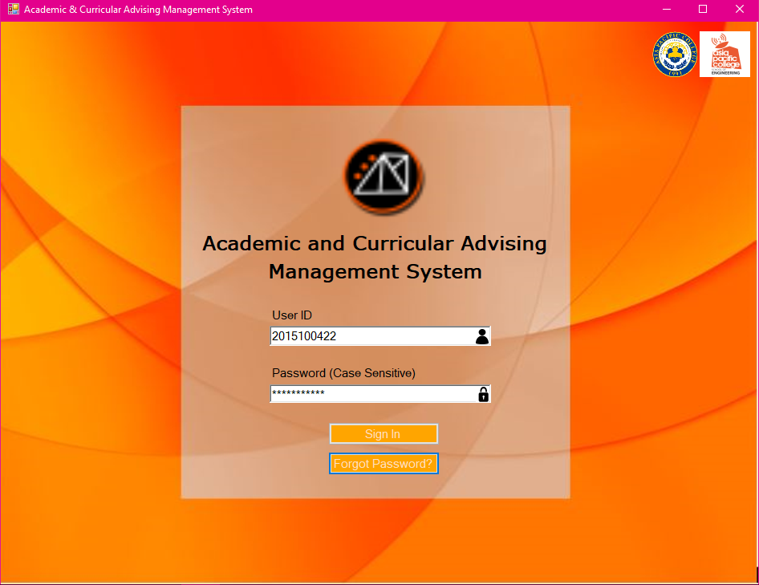
LOG IN
PROBLEM
PROPOSED SOLUTION
OBJECTIVES
USER
LOG IN
USER HOMEPAGE
REGISTRATION
FORGOT PASSWORD
CASE
GENERATE REPORTS
IMPORT FROM EXCEL FILE
Academic and Curricular advising Management System

Slide 16
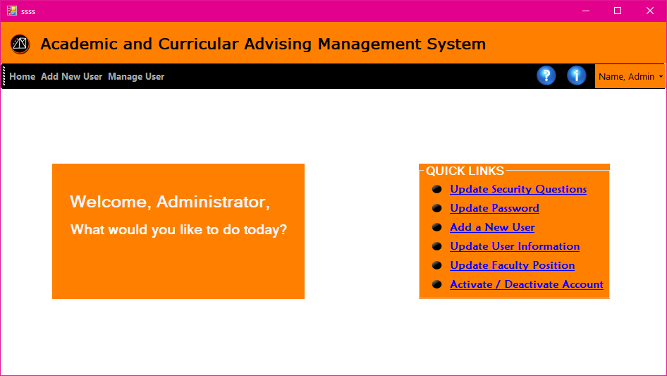
HOMEPAGE | ADMIN
PROBLEM
PROPOSED SOLUTION
OBJECTIVES
USER
LOG IN
USER HOMEPAGE
REGISTRATION
FORGOT PASSWORD
CASE
GENERATE REPORTS
IMPORT FROM EXCEL FILE
Academic and Curricular advising Management System

Slide 17
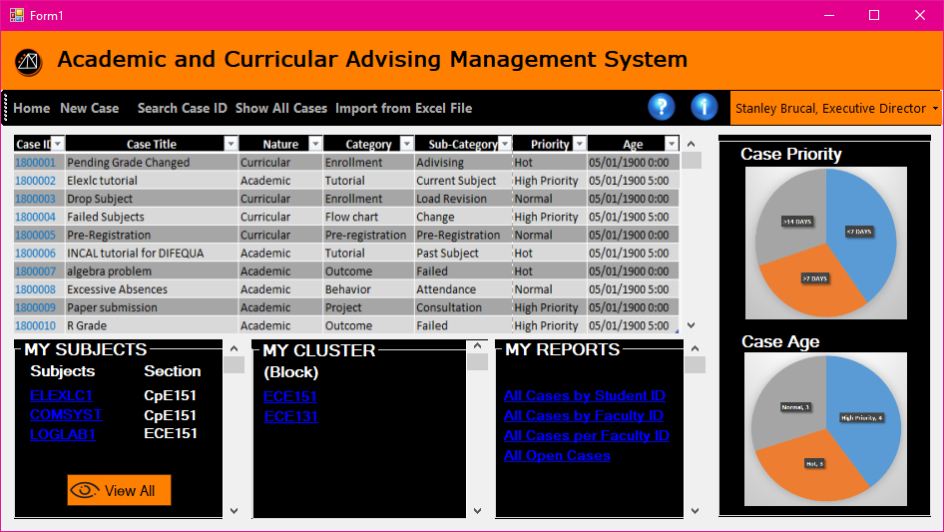
HOMEPAGE | EXECUTIVE DIRECTOR
PROBLEM
PROPOSED SOLUTION
OBJECTIVES
USER
LOG IN
USER HOMEPAGE
REGISTRATION
FORGOT PASSWORD
CASE
GENERATE REPORTS
IMPORT FROM EXCEL FILE
Academic and Curricular advising Management System

Slide 18
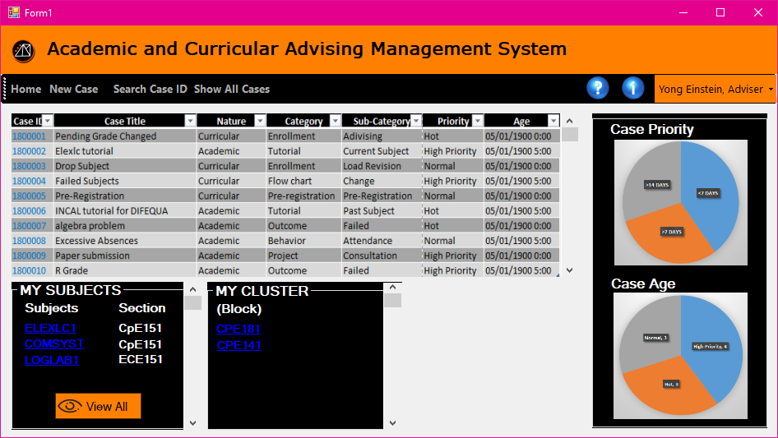
HOMEPAGE | ADVISER
PROBLEM
PROPOSED SOLUTION
OBJECTIVES
USER
LOG IN
USER HOMEPAGE
REGISTRATION
FORGOT PASSWORD
CASE
GENERATE REPORTS
IMPORT FROM EXCEL FILE
CPE 151
Academic and Curricular advising Management System

Slide 19
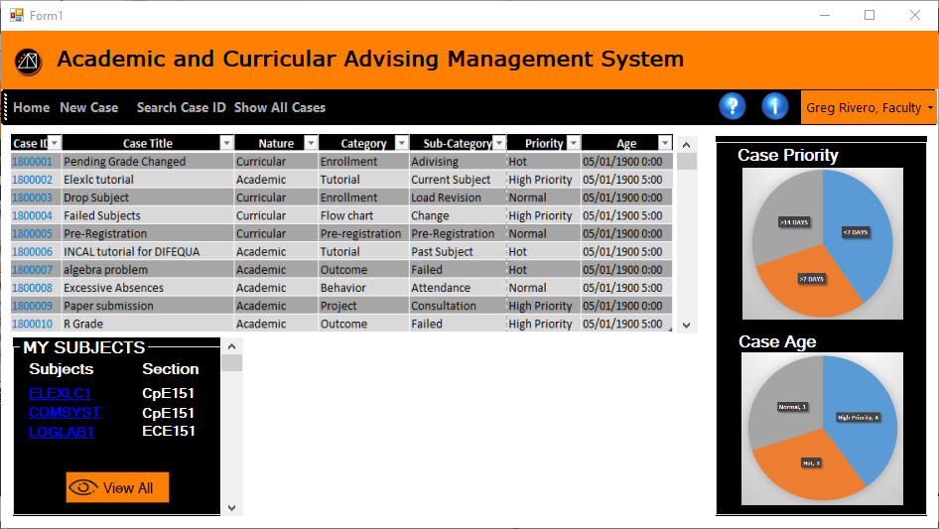
HOMEPAGE | FACULTY
PROBLEM
PROPOSED SOLUTION
OBJECTIVES
USER
LOG IN
USER HOMEPAGE
REGISTRATION
FORGOT PASSWORD
CASE
GENERATE REPORTS
IMPORT FROM EXCEL FILE
Academic and Curricular advising Management System

Slide 20
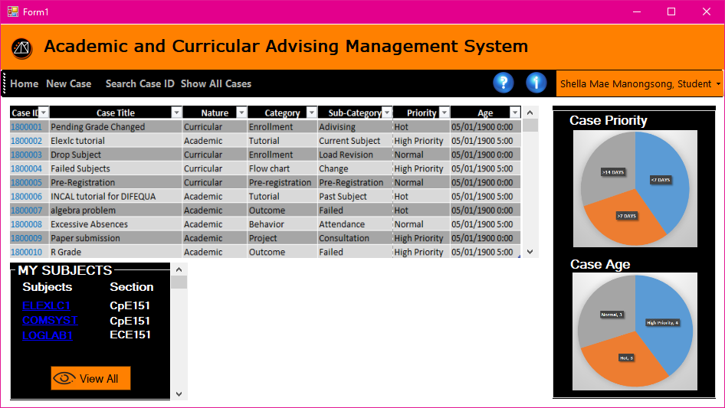
HOMEPAGE | STUDENT
PROBLEM
PROPOSED SOLUTION
OBJECTIVES
USER
LOG IN
USER HOMEPAGE
REGISTRATION
FORGOT PASSWORD
CASE
GENERATE REPORTS
IMPORT FROM EXCEL FILE
Academic and Curricular advising Management System

Slide 21
REGISTRATION | FROM ADMIN HOMEPAGE -> SELECT ADD NEW USER
PROBLEM
PROPOSED SOLUTION
OBJECTIVES
USER
LOG IN
USER HOMEPAGE
REGISTRATION
FORGOT PASSWORD
CASE
GENERATE REPORTS
IMPORT FROM EXCEL FILE
Academic and Curricular advising Management System

Slide 22
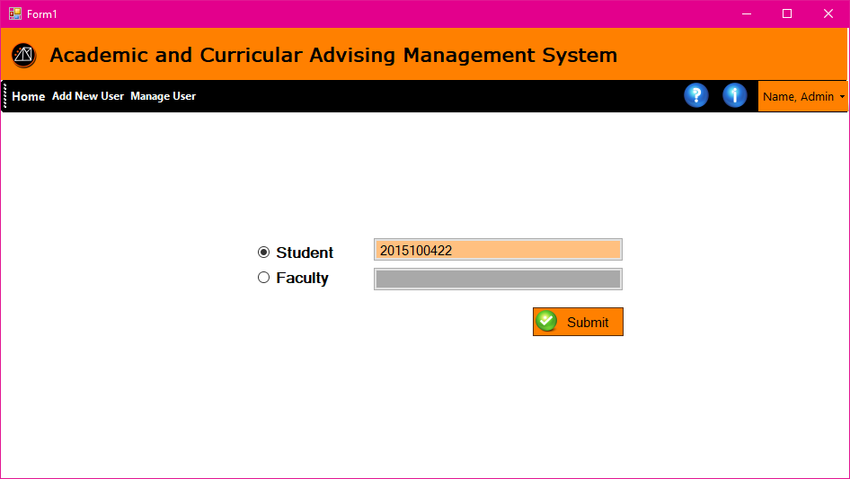
REGISTRATION | REGISTRATION ACCOUNT VERIFICATION
PROBLEM
PROPOSED SOLUTION
OBJECTIVES
USER
LOG IN
USER HOMEPAGE
REGISTRATION
FORGOT PASSWORD
CASE
GENERATE REPORTS
IMPORT FROM EXCEL FILE
Academic and Curricular advising Management System

Slide 23
REGISTRATION | REGISTRATION ACCOUNT VERIFICATION
PROBLEM
PROPOSED SOLUTION
OBJECTIVES
USER
LOG IN
USER HOMEPAGE
REGISTRATION
FORGOT PASSWORD
CASE
GENERATE REPORTS
IMPORT FROM EXCEL FILE
Academic and Curricular advising Management System

Slide 24
REGISTRATION | REGISTRATION ACCOUNT VERIFICATION
PROBLEM
PROPOSED SOLUTION
OBJECTIVES
USER
LOG IN
USER HOMEPAGE
REGISTRATION
FORGOT PASSWORD
CASE
GENERATE REPORTS
IMPORT FROM EXCEL FILE
Academic and Curricular advising Management System

Slide 25
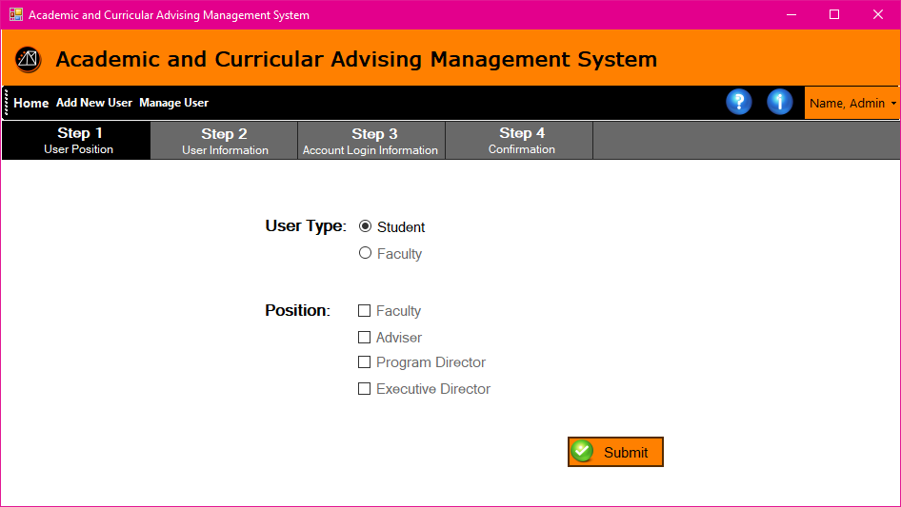
REGISTRATION | STEP 1: USER POSITION
PROBLEM
PROPOSED SOLUTION
OBJECTIVES
USER
LOG IN
USER HOMEPAGE
REGISTRATION
FORGOT PASSWORD
CASE
GENERATE REPORTS
IMPORT FROM EXCEL FILE
Academic and Curricular advising Management System

Slide 26
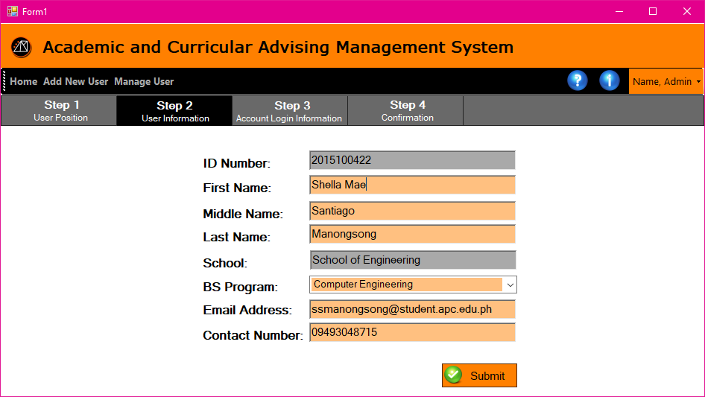
REGISTRATION | STEP 2: USER INFORMATION
PROBLEM
PROPOSED SOLUTION
OBJECTIVES
USER
LOG IN
USER HOMEPAGE
REGISTRATION
FORGOT PASSWORD
CASE
GENERATE REPORTS
IMPORT FROM EXCEL FILE
Academic and Curricular advising Management System

Slide 27
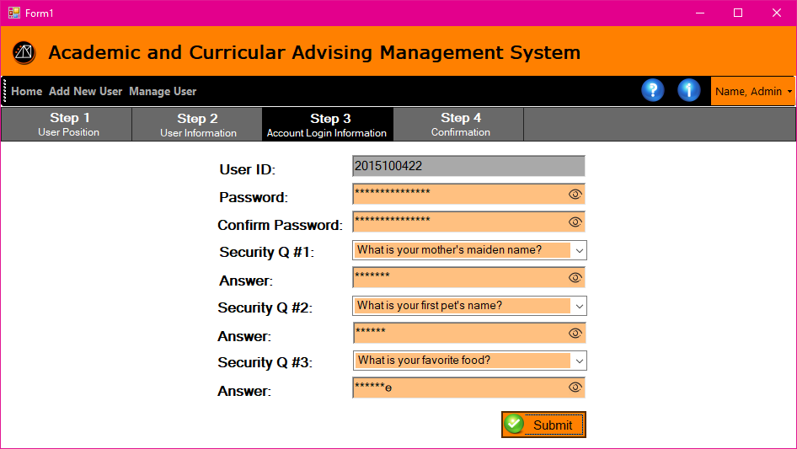
REGISTRATION | STEP 3: ACCOUNT LOG IN INFORMATION
PROBLEM
PROPOSED SOLUTION
OBJECTIVES
USER
LOG IN
USER HOMEPAGE
REGISTRATION
FORGOT PASSWORD
CASE
GENERATE REPORTS
IMPORT FROM EXCEL FILE
Academic and Curricular advising Management System

Slide 28
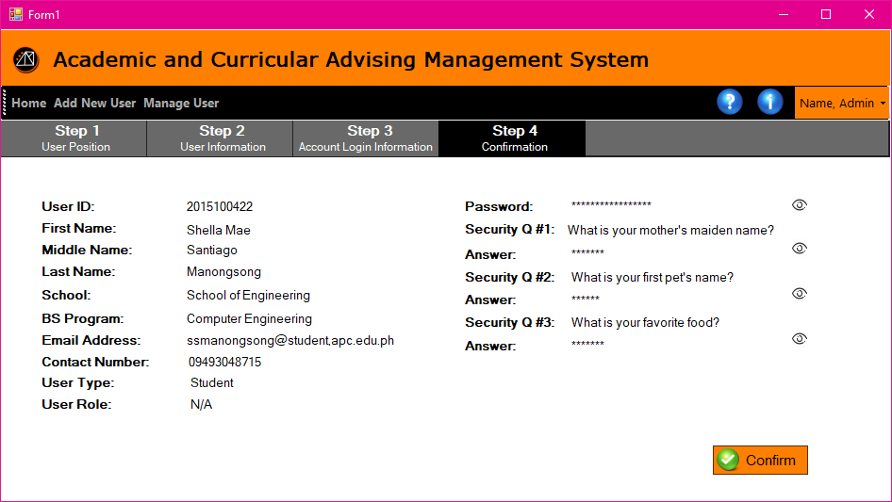
REGISTRATION | USER INFORMATION SUMMARY
PROBLEM
PROPOSED SOLUTION
OBJECTIVES
USER
LOG IN
USER HOMEPAGE
REGISTRATION
FORGOT PASSWORD
CASE
GENERATE REPORTS
IMPORT FROM EXCEL FILE
Academic and Curricular advising Management System

Slide 29
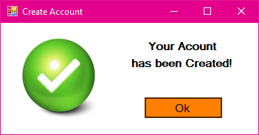
REGISTRATION | CONFIRMATION
PROBLEM
PROPOSED SOLUTION
OBJECTIVES
USER
LOG IN
USER HOMEPAGE
REGISTRATION
FORGOT PASSWORD
CASE
GENERATE REPORTS
IMPORT FROM EXCEL FILE
Academic and Curricular advising Management System

Slide 30
REGISTRATION | FROM ADMIN HOMEPAGE -> SELECT ADD NEW USER
PROBLEM
PROPOSED SOLUTION
OBJECTIVES
USER
LOG IN
USER HOMEPAGE
REGISTRATION
FORGOT PASSWORD
CASE
GENERATE REPORTS
IMPORT FROM EXCEL FILE
Academic and Curricular advising Management System

Slide 31
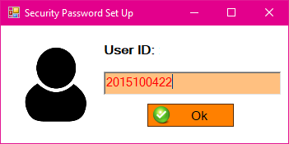
FORGOT PASSWORD | USER ID INPUT FIELD
PROBLEM
PROPOSED SOLUTION
OBJECTIVES
USER
LOG IN
USER HOMEPAGE
REGISTRATION
FORGOT PASSWORD
CASE
GENERATE REPORTS
IMPORT FROM EXCEL FILE
Academic and Curricular advising Management System

Slide 32
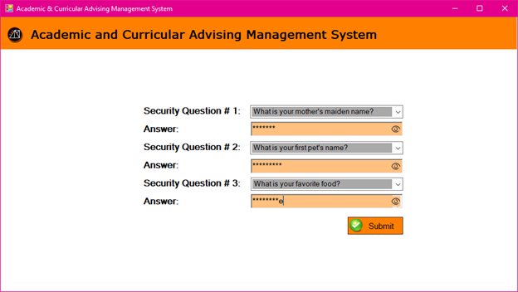
FORGOT PASSWORD | SECURITY QUESTIONS
PROBLEM
PROPOSED SOLUTION
OBJECTIVES
USER
LOG IN
USER HOMEPAGE
REGISTRATION
FORGOT PASSWORD
CASE
GENERATE REPORTS
IMPORT FROM EXCEL FILE
Academic and Curricular advising Management System

Slide 33
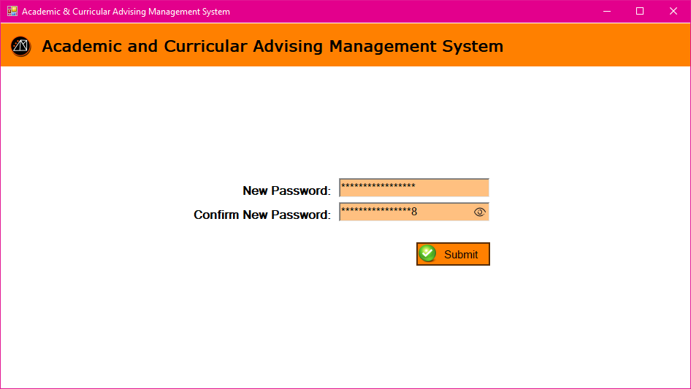
FORGOT PASSWORD | SETTING UP NEW PASSWORD
PROBLEM
PROPOSED SOLUTION
OBJECTIVES
USER
LOG IN
USER HOMEPAGE
REGISTRATION
FORGOT PASSWORD
CASE
GENERATE REPORTS
IMPORT FROM EXCEL FILE
Academic and Curricular advising Management System

Slide 34
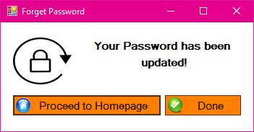
FORGOT PASSWORD | PASSWORD CHANGE CONFIRMATION
PROBLEM
PROPOSED SOLUTION
OBJECTIVES
USER
LOG IN
USER HOMEPAGE
REGISTRATION
FORGOT PASSWORD
CASE
GENERATE REPORTS
IMPORT FROM EXCEL FILE
Academic and Curricular advising Management System

Slide 35
CASE | ATTRIBUTES
PROBLEM
PROPOSED SOLUTION
OBJECTIVES
USER
LOG IN
USER HOMEPAGE
REGISTRATION
FORGOT PASSWORD
CASE
GENERATE REPORTS
IMPORT FROM EXCEL FILE
Age | Nature
Case Closed | Notes
Case Created | Priority
Case ID | Status
Case Owner | Sub-Category
Category | Subject
Cluster | Title
Faculty
Academic and Curricular advising Management System

Slide 36
CASE | CREATE CASE | XD/PD/ADVISER
PROBLEM
PROPOSED SOLUTION
OBJECTIVES
USER
LOG IN
USER HOMEPAGE
REGISTRATION
FORGOT PASSWORD
CASE
GENERATE REPORTS
IMPORT FROM EXCEL FILE
CPE 151
Academic and Curricular advising Management System

Slide 37
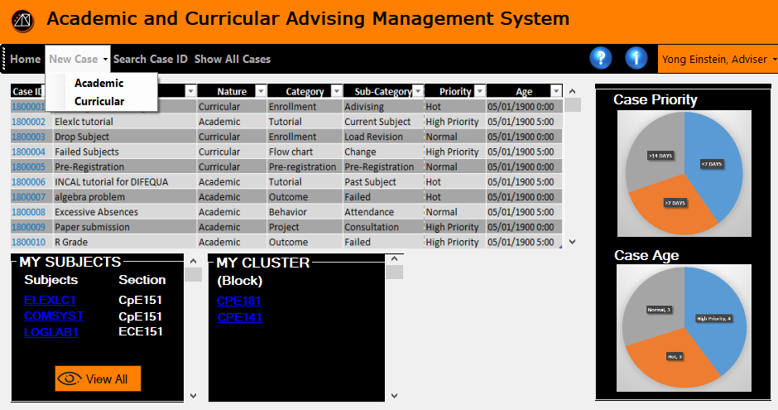
CASE | CREATE CASE | XD/PD/ADVISER
PROBLEM
PROPOSED SOLUTION
OBJECTIVES
USER
LOG IN
USER HOMEPAGE
REGISTRATION
FORGOT PASSWORD
CASE
GENERATE REPORTS
IMPORT FROM EXCEL FILE
CPE 151
Academic and Curricular advising Management System

Slide 38
CASE | CREATE CASE | FACULTY
PROBLEM
PROPOSED SOLUTION
OBJECTIVES
USER
LOG IN
USER HOMEPAGE
REGISTRATION
FORGOT PASSWORD
CASE
GENERATE REPORTS
IMPORT FROM EXCEL FILE
Academic and Curricular advising Management System

Slide 39
CASE | CREATE CASE | STUDENT
PROBLEM
PROPOSED SOLUTION
OBJECTIVES
USER
LOG IN
USER HOMEPAGE
REGISTRATION
FORGOT PASSWORD
CASE
GENERATE REPORTS
IMPORT FROM EXCEL FILE
Academic and Curricular advising Management System

Slide 40
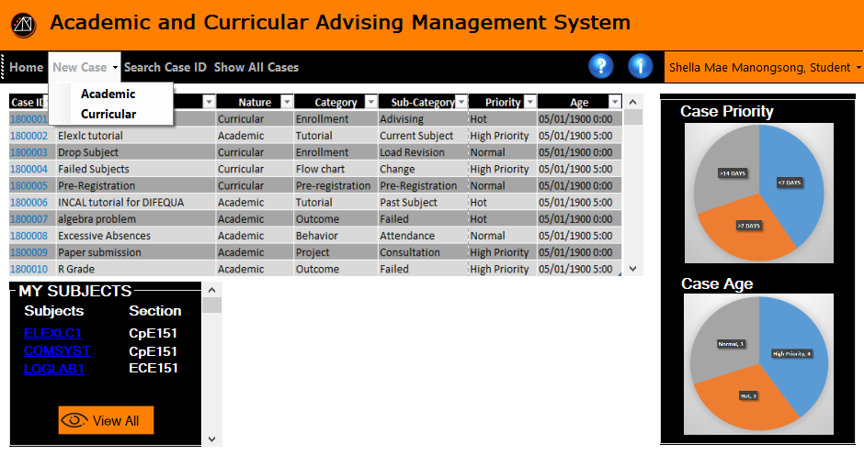
CASE | CREATE CASE | STUDENT
PROBLEM
PROPOSED SOLUTION
OBJECTIVES
USER
LOG IN
USER HOMEPAGE
REGISTRATION
FORGOT PASSWORD
CASE
GENERATE REPORTS
IMPORT FROM EXCEL FILE
Academic and Curricular advising Management System

Slide 41
CASE | RETRIEVE CASE | XD/PD/ADVISER/FACULTY
PROBLEM
PROPOSED SOLUTION
OBJECTIVES
USER
LOG IN
USER HOMEPAGE
REGISTRATION
FORGOT PASSWORD
CASE
GENERATE REPORTS
IMPORT FROM EXCEL FILE
CPE 151
Academic and Curricular advising Management System

Slide 42
CASE | RETRIEVE CASE | XD/PD/ADVISER/FACULTY
PROBLEM
PROPOSED SOLUTION
OBJECTIVES
USER
LOG IN
USER HOMEPAGE
REGISTRATION
FORGOT PASSWORD
CASE
GENERATE REPORTS
IMPORT FROM EXCEL FILE
Academic and Curricular advising Management System

Slide 43
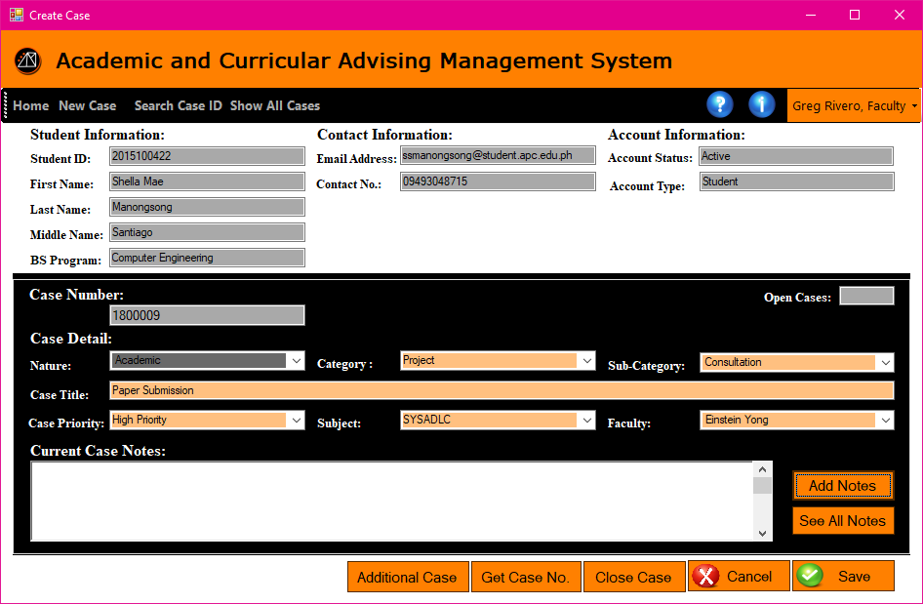
CASE | CASE PAGE
PROBLEM
PROPOSED SOLUTION
OBJECTIVES
USER
LOG IN
USER HOMEPAGE
REGISTRATION
FORGOT PASSWORD
CASE
GENERATE REPORTS
IMPORT FROM EXCEL FILE
Academic and Curricular advising Management System

Slide 44
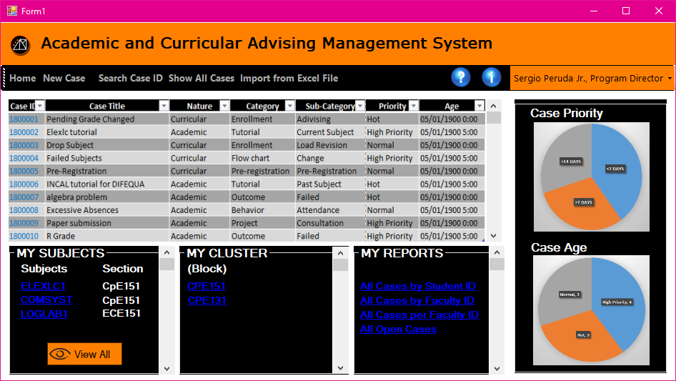
GENERATE REPORTS| XD/PD
PROBLEM
PROPOSED SOLUTION
OBJECTIVES
USER
LOG IN
USER HOMEPAGE
REGISTRATION
RESET PASSWORD
CASE
GENERATE REPORTS
IMPORT FROM EXCEL FILE
Academic and Curricular advising Management System

Slide 45
IMPORT FROM EXCEL FILE | XD/PD
PROBLEM
PROPOSED SOLUTION
OBJECTIVES
USER
LOG IN
USER HOMEPAGE
REGISTRATION
RESET PASSWORD
CASE
GENERATE REPORTS
IMPORT FROM EXCEL FILE
Academic and Curricular advising Management System

Slide 46
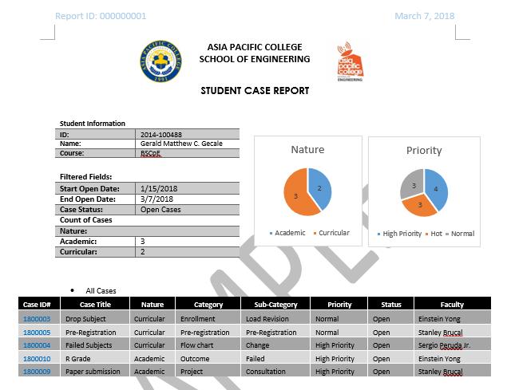
GENERATE REPORTS| SAMPLE REPORTS | BY STUDENT
PROBLEM
PROPOSED SOLUTION
OBJECTIVES
USER
LOG IN
USER HOMEPAGE
REGISTRATION
FORGOT PASSWORD
CASE
GENERATE REPORTS
IMPORT FROM EXCEL FILE
Academic and Curricular advising Management System

Slide 47
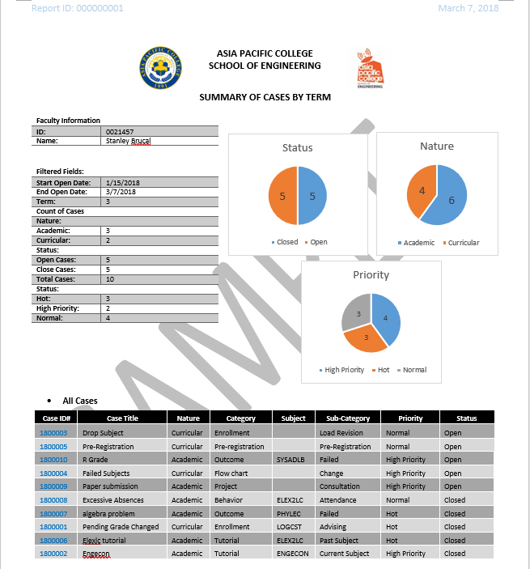
GENERATE REPORTS| SAMPLE REPORTS | BY FACULTY
PROBLEM
PROPOSED SOLUTION
OBJECTIVES
USER
LOG IN
USER HOMEPAGE
REGISTRATION
FORGOT PASSWORD
CASE
GENERATE REPORTS
IMPORT FROM EXCEL FILE
Academic and Curricular advising Management System

Slide 48
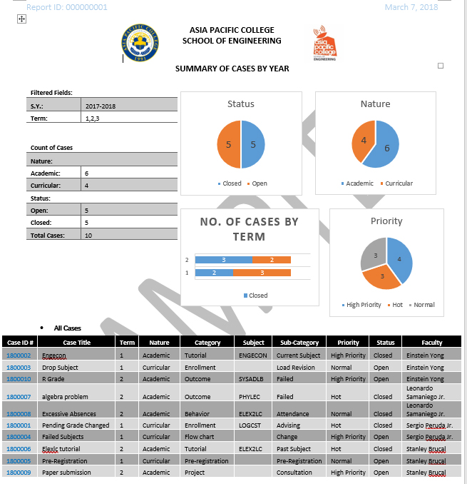
GENERATE REPORTS| SAMPLE REPORTS | ALL CASES
PROBLEM
PROPOSED SOLUTION
OBJECTIVES
USER
LOG IN
USER HOMEPAGE
REGISTRATION
FORGOT PASSWORD
CASE
GENERATE REPORTS
IMPORT FROM EXCEL FILE
Academic and Curricular advising Management System

Slide 49
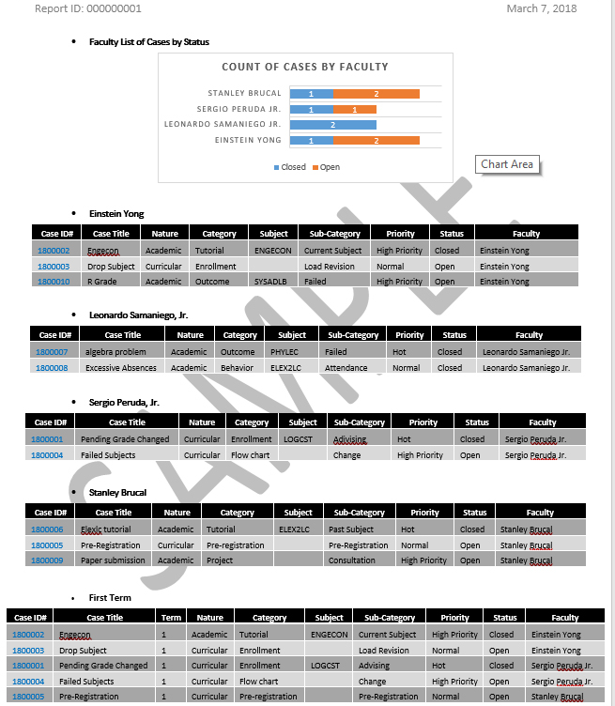
PROBLEM
PROPOSED SOLUTION
OBJECTIVES
USER
LOG IN
USER HOMEPAGE
REGISTRATION
FORGOT PASSWORD
CASE
GENERATE REPORTS
IMPORT FROM EXCEL FILE
Academic and Curricular advising Management System

Slide 50
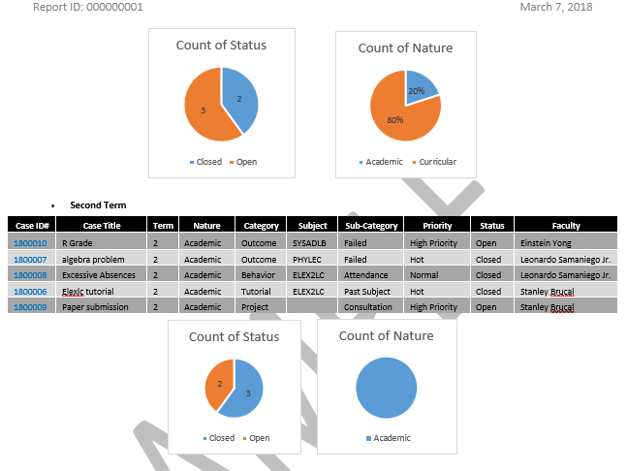
GENERATE REPORTS| SAMPLE REPORTS | ALL CASES
PROBLEM
PROPOSED SOLUTION
OBJECTIVES
USER
LOG IN
USER HOMEPAGE
REGISTRATION
FORGOT PASSWORD
CASE
GENERATE REPORTS
IMPORT FROM EXCEL FILE
Academic and Curricular advising Management System

Slide 51
THANK YOU ☺
By:
Alejandro, Rosemarie
Gecale, Gerald Matthew
Manongsong, Shella Mae
Marinda, Hamill Jhon
Academic and Curricular advising Management System

Slide 52
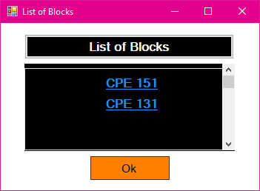
CASE
PROBLEM
PROPOSED SOLUTION
OBJECTIVES
USER
LOG IN
USER HOMEPAGE
REGISTRATION
FORGOT PASSWORD
CASE
GENERATE REPORTS
IMPORT FROM EXCEL FILE
Academic and Curricular Advising Management System

Slide 53
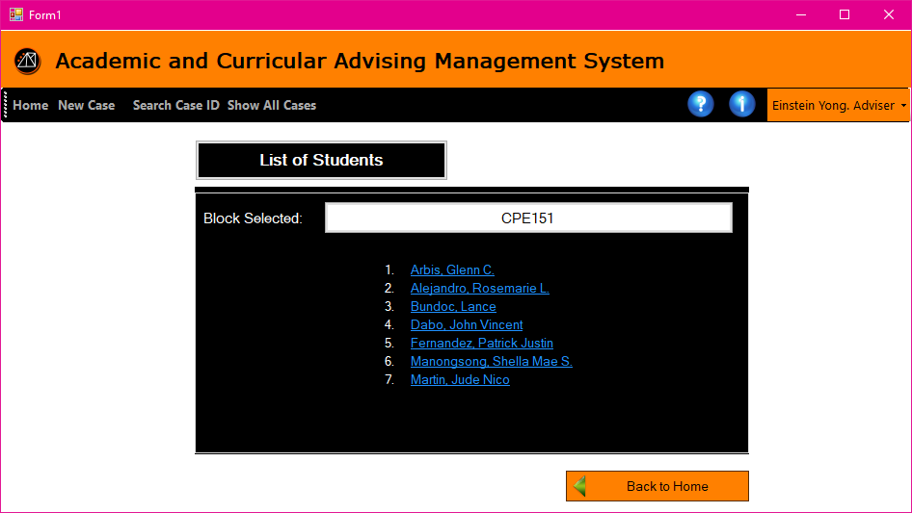
CASE
PROBLEM
PROPOSED SOLUTION
OBJECTIVES
USER
LOG IN
USER HOMEPAGE
REGISTRATION
FORGOT PASSWORD
CASE
GENERATE REPORTS
IMPORT FROM EXCEL FILE
Academic and Curricular advising Management System

Slide 54
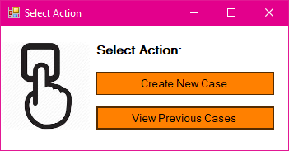
CASE
PROBLEM
PROPOSED SOLUTION
OBJECTIVES
USER
LOG IN
USER HOMEPAGE
REGISTRATION
FORGOT PASSWORD
CASE
GENERATE REPORTS
IMPORT FROM EXCEL FILE
Academic and Curricular advising Management System

Slide 55
CASE
PROBLEM
PROPOSED SOLUTION
OBJECTIVES
USER
LOG IN
USER HOMEPAGE
REGISTRATION
FORGOT PASSWORD
CASE
GENERATE REPORTS
IMPORT FROM EXCEL FILE
Academic and Curricular advising Management System

Slide 56
CASE
PROBLEM
PROPOSED SOLUTION
OBJECTIVES
USER
LOG IN
USER HOMEPAGE
REGISTRATION
FORGOT PASSWORD
CASE
GENERATE REPORTS
IMPORT FROM EXCEL FILE
Academic and Curricular advising Management System

Slide 57

CASE
PROBLEM
PROPOSED SOLUTION
OBJECTIVES
USER
LOG IN
USER HOMEPAGE
REGISTRATION
FORGOT PASSWORD
CASE
GENERATE REPORTS
IMPORT FROM EXCEL FILE
Academic and Curricular advising Management System

Slide 58
CASE
PROBLEM
PROPOSED SOLUTION
OBJECTIVES
USER
LOG IN
USER HOMEPAGE
REGISTRATION
FORGOT PASSWORD
CASE
GENERATE REPORTS
IMPORT FROM EXCEL FILE
Academic and Curricular advising Management System

Slide 59
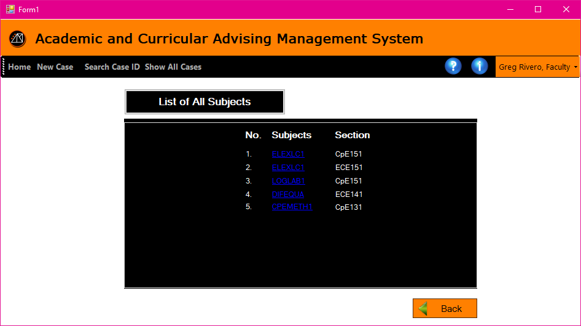
CASE
PROBLEM
PROPOSED SOLUTION
OBJECTIVES
USER
LOG IN
USER HOMEPAGE
REGISTRATION
FORGOT PASSWORD
CASE
GENERATE REPORTS
IMPORT FROM EXCEL FILE
Academic and Curricular advising Management System

Slide 60
CASE
PROBLEM
PROPOSED SOLUTION
OBJECTIVES
USER
LOG IN
USER HOMEPAGE
REGISTRATION
FORGOT PASSWORD
CASE
GENERATE REPORTS
IMPORT FROM EXCEL FILE
Academic and Curricular advising Management System

Slide 61
CASE
PROBLEM
PROPOSED SOLUTION
OBJECTIVES
USER
LOG IN
USER HOMEPAGE
REGISTRATION
FORGOT PASSWORD
CASE
GENERATE REPORTS
IMPORT FROM EXCEL FILE
Academic and Curricular advising Management System

Slide 62
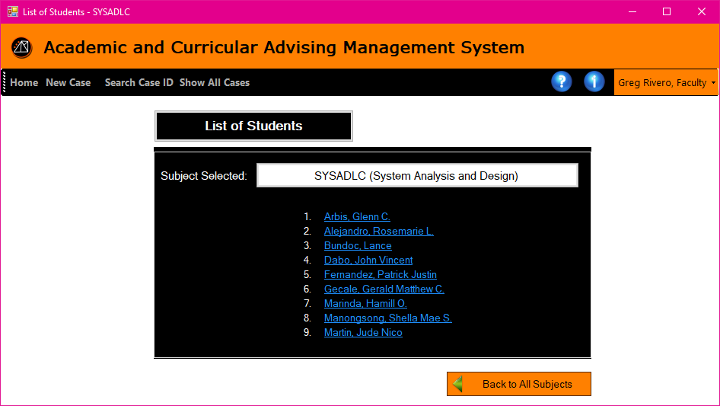
CASE
PROBLEM
PROPOSED SOLUTION
OBJECTIVES
USER
LOG IN
USER HOMEPAGE
REGISTRATION
FORGOT PASSWORD
CASE
GENERATE REPORTS
IMPORT FROM EXCEL FILE
ELEXLC1
Academic and Curricular advising Management System

Slide 63
CASE
PROBLEM
PROPOSED SOLUTION
OBJECTIVES
USER
LOG IN
USER HOMEPAGE
REGISTRATION
FORGOT PASSWORD
CASE
GENERATE REPORTS
IMPORT FROM EXCEL FILE
ELEXLC1
Academic and Curricular advising Management System

Slide 64
CASE
PROBLEM
PROPOSED SOLUTION
OBJECTIVES
USER
LOG IN
USER HOMEPAGE
REGISTRATION
FORGOT PASSWORD
CASE
GENERATE REPORTS
IMPORT FROM EXCEL FILE
Academic and Curricular advising Management System

Slide 65
CASE
PROBLEM
PROPOSED SOLUTION
OBJECTIVES
USER
LOG IN
USER HOMEPAGE
REGISTRATION
FORGOT PASSWORD
CASE
GENERATE REPORTS
IMPORT FROM EXCEL FILE
Academic and Curricular advising Management System

Slide 66
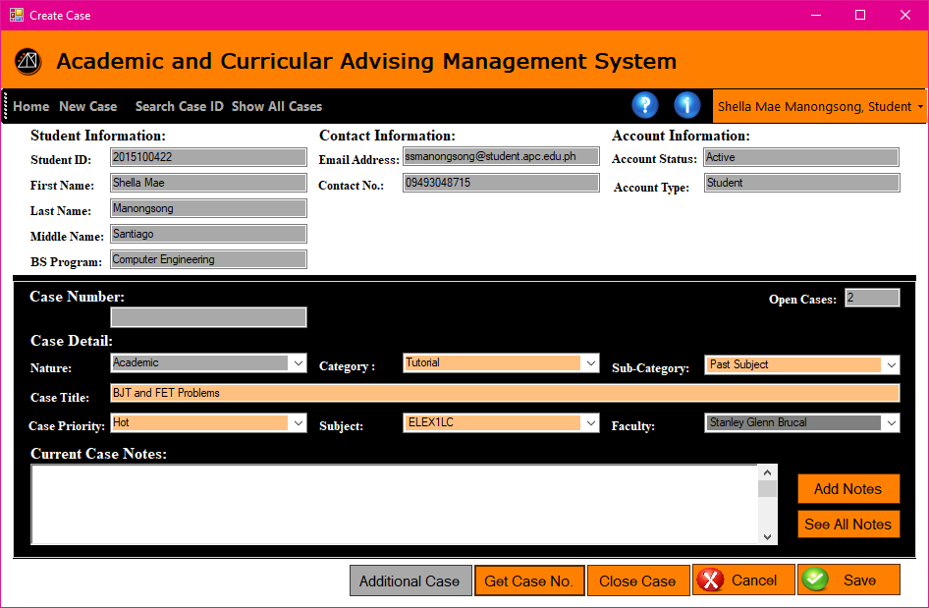
CASE
PROBLEM
PROPOSED SOLUTION
OBJECTIVES
USER
LOG IN
USER HOMEPAGE
REGISTRATION
FORGOT PASSWORD
CASE
GENERATE REPORTS
IMPORT FROM EXCEL FILE
Academic and Curricular advising Management System

Slide 67
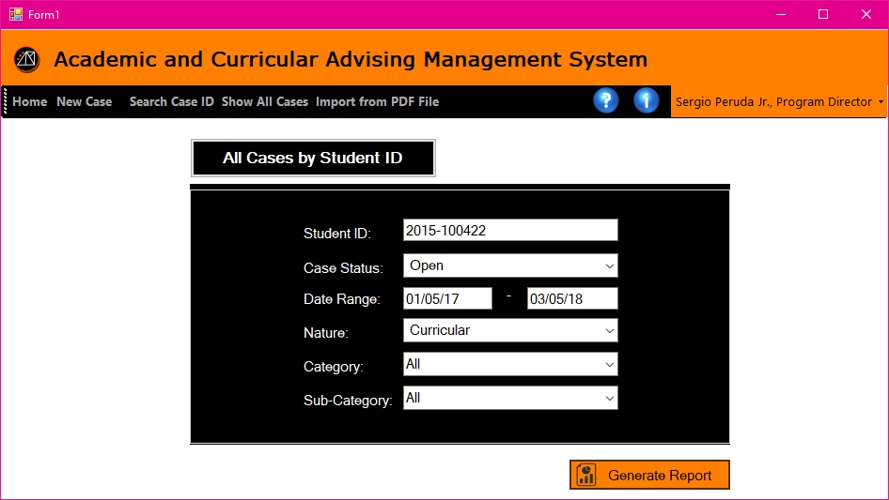
GENERATE REPORTS| XD/PD
PROBLEM
PROPOSED SOLUTION
OBJECTIVES
USER
LOG IN
USER HOMEPAGE
REGISTRATION
FORGOT PASSWORD
CASE
GENERATE REPORTS
IMPORT FROM EXCEL FILE
Academic and Curricular advising Management System

Slide 68
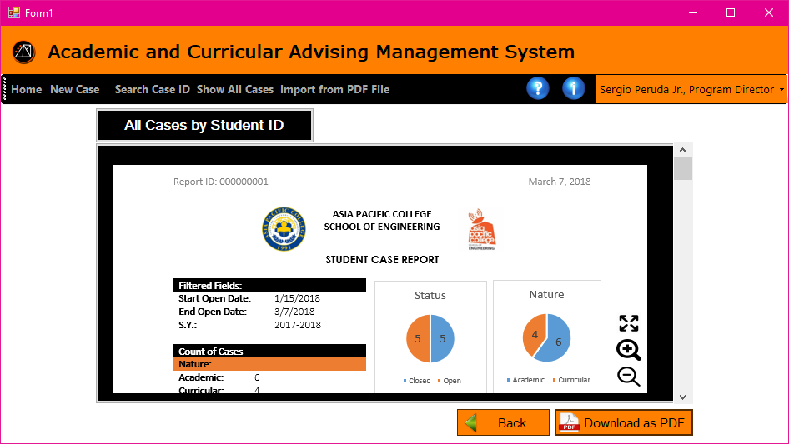
GENERATE REPORTS| XD/PD
PROBLEM
PROPOSED SOLUTION
OBJECTIVES
USER
LOG IN
USER HOMEPAGE
REGISTRATION
FORGOT PASSWORD
CASE
GENERATE REPORTS
IMPORT FROM EXCEL FILE
Academic and Curricular advising Management System

Slide 69
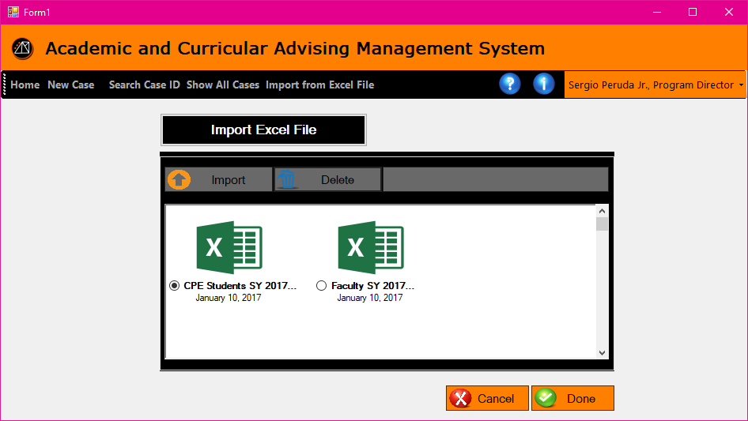
IMPORT FROM EXCEL FILE | XD/PD
PROBLEM
PROPOSED SOLUTION
OBJECTIVES
USER
LOG IN
USER HOMEPAGE
REGISTRATION
FORGOT PASSWORD
CASE
GENERATE REPORTS
IMPORT FROM EXCEL FILE
Academic and Curricular advising Management System

Slide 70
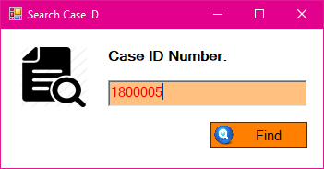
CASE
PROBLEM
PROPOSED SOLUTION
OBJECTIVES
USER
LOG IN
USER HOMEPAGE
REGISTRATION
FORGOT PASSWORD
CASE
GENERATE REPORTS
IMPORT FROM EXCEL FILE
1800004
Academic and Curricular advising Management System

Slide 71
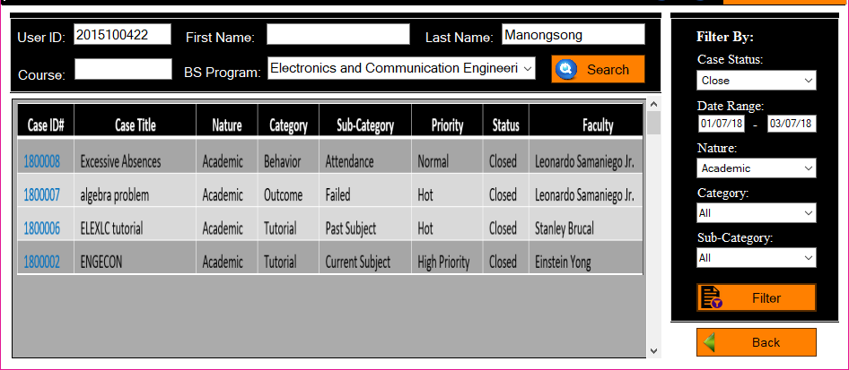
CASE
PROBLEM
PROPOSED SOLUTION
OBJECTIVES
USER
LOG IN
USER HOMEPAGE
REGISTRATION
FORGOT PASSWORD
CASE
GENERATE REPORTS
IMPORT FROM EXCEL FILE
Academic and Curricular advising Management System

Slide 72
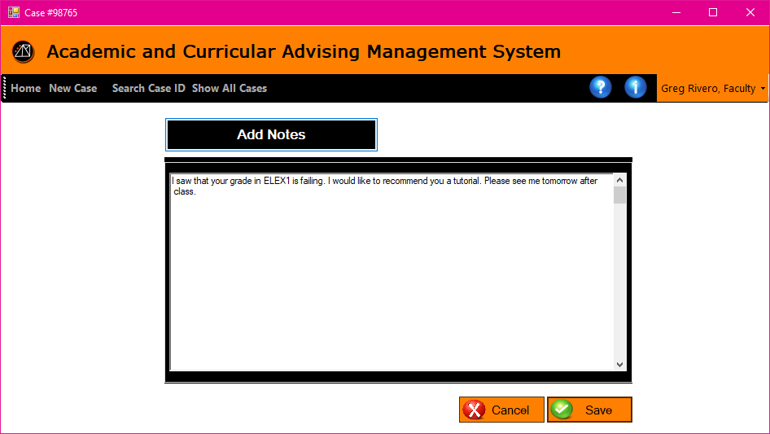
CASE | ADD NOTES
PROBLEM
PROPOSED SOLUTION
OBJECTIVES
USER
LOG IN
USER HOMEPAGE
REGISTRATION
FORGOT PASSWORD
CASE
GENERATE REPORTS
IMPORT FROM EXCEL FILE
Academic and Curricular advising Management System

Slide 73
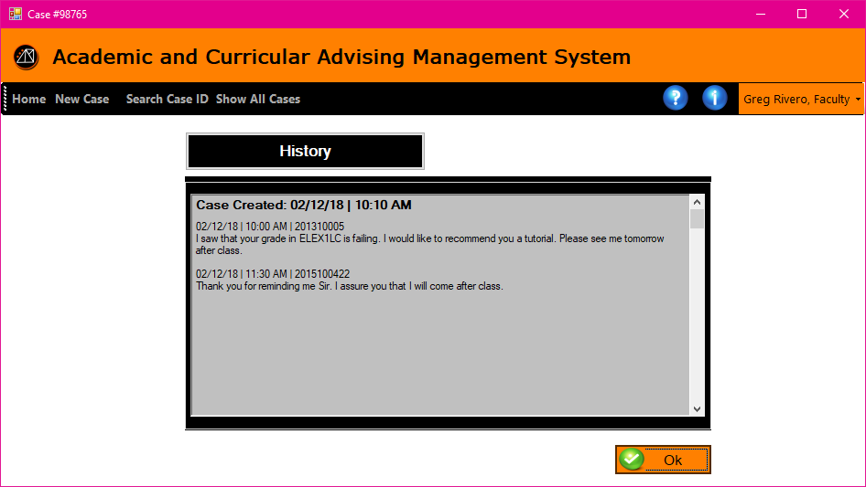
CASE | VIEW NOTES
PROBLEM
PROPOSED SOLUTION
OBJECTIVES
USER
LOG IN
USER HOMEPAGE
REGISTRATION
FORGOT PASSWORD
CASE
GENERATE REPORTS
IMPORT FROM EXCEL FILE
Academic and Curricular advising Management System

Slide 74
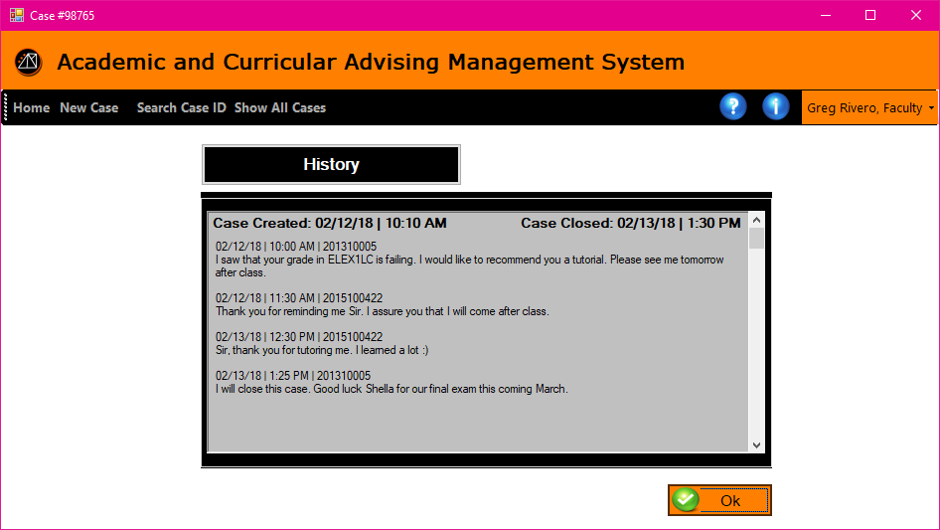
CASE | VIEW NOTES
PROBLEM
PROPOSED SOLUTION
OBJECTIVES
USER
LOG IN
USER HOMEPAGE
REGISTRATION
FORGOT PASSWORD
CASE
GENERATE REPORTS
IMPORT FROM EXCEL FILE
Academic and Curricular advising Management System

Slide 75
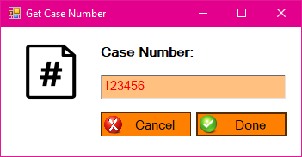
CASE | GET CASE NUMBER
PROBLEM
PROPOSED SOLUTION
OBJECTIVES
USER
LOG IN
USER HOMEPAGE
REGISTRATION
FORGOT PASSWORD
CASE
GENERATE REPORTS
IMPORT FROM EXCEL FILE
Academic and Curricular advising Management System

